Slide 1


Slide 2
INTRODUCTION
What is Page Rank (PR)?
Why do we need it?

Slide 3
Page Rank (PR)
PageRank is a “vote”, by all the other pages on the Web, about how important a page is.
A link to a page counts as a vote of support

Slide 4

INTRODUCTION

Slide 5
Terminology
What terms should we know?

Slide 6
Breakdown of Equation
Now we refer PageRank as “PR”
PR(A) = (1-d) + d (PR(T1) / C(T1) + ….. + PR(Tn) / C(Tn) )
PR(A) is the PageRank of page A
PR(Ti) is the PageRank of pages Ti which link to page A
C(Ti) is the number of outbound links on page Ti
d is a damping factor which can be set between 0 and 1
(usually set to 0.85)
A page’s PageRank = 0.15 + 0.85 * (a “share” of the PageRank of
every page that links to it)
“share” = the linking page’s PageRank divided by the number of
outbound links on the page
Notes:
6

Slide 7
Page A
Page B
PR = 1
PR = 1
We can't work out A's PageRank until we know B's PageRank, and we can't work
out B's PageRank until we know A's PageRank.
Iterations are necessary to calculate the most accurate values by
using inaccurate values
100 iterations are necessary to get a good approximation of the
PageRank values of the whole web
Outgoing link of page A = C(A) = 1
Outgoing link of page B = C(B) = 1
Notes:
7

Slide 8
Page Rank Algorithm
How to calculate ranks?
This example is without damping factor

Slide 9
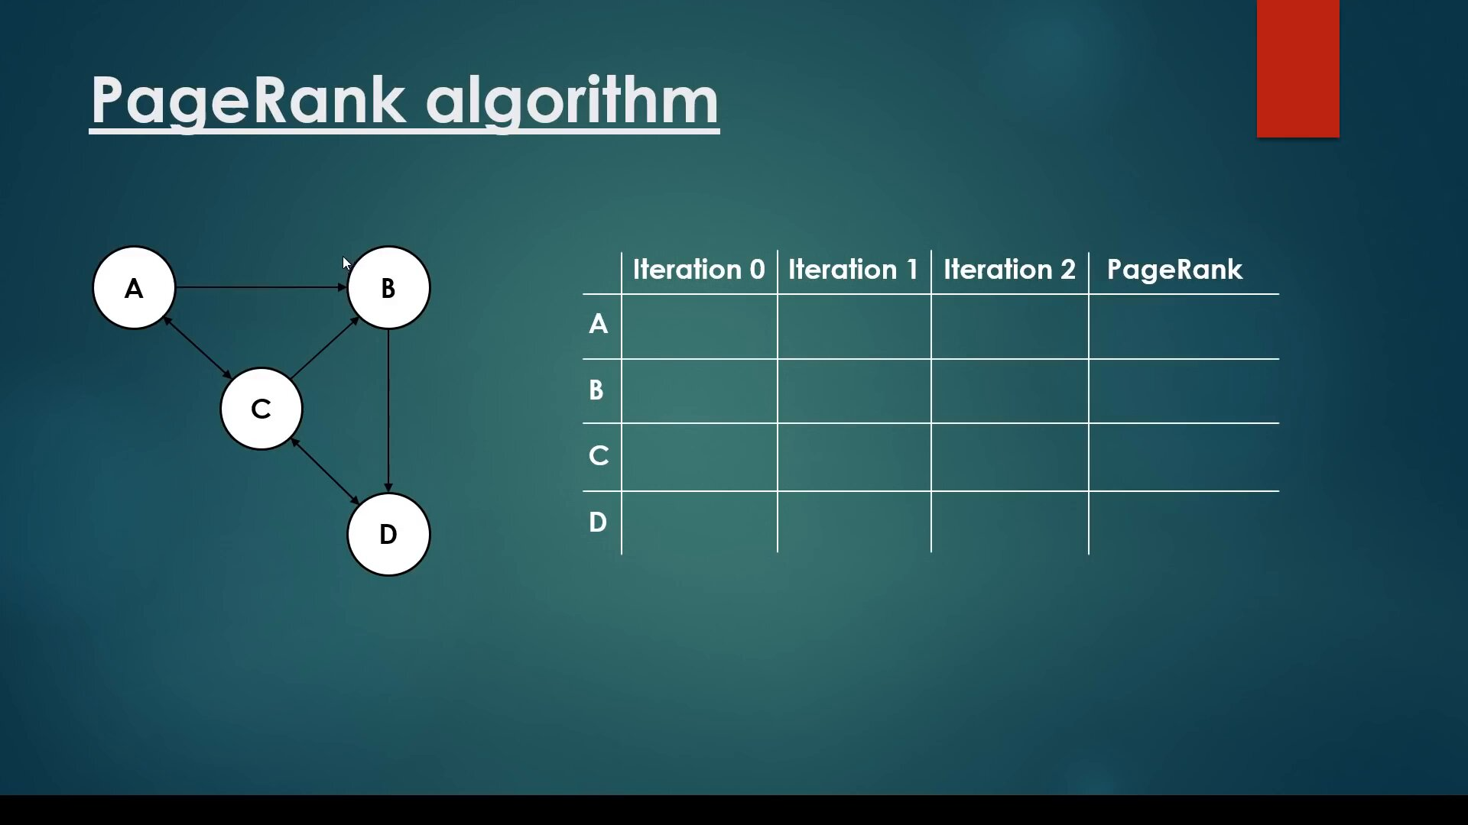
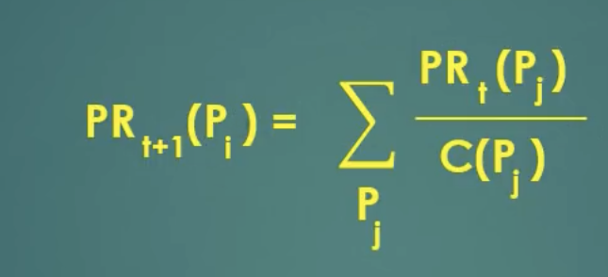
Initilize all page ranks using uniform distribution at iteration 0

Slide 10
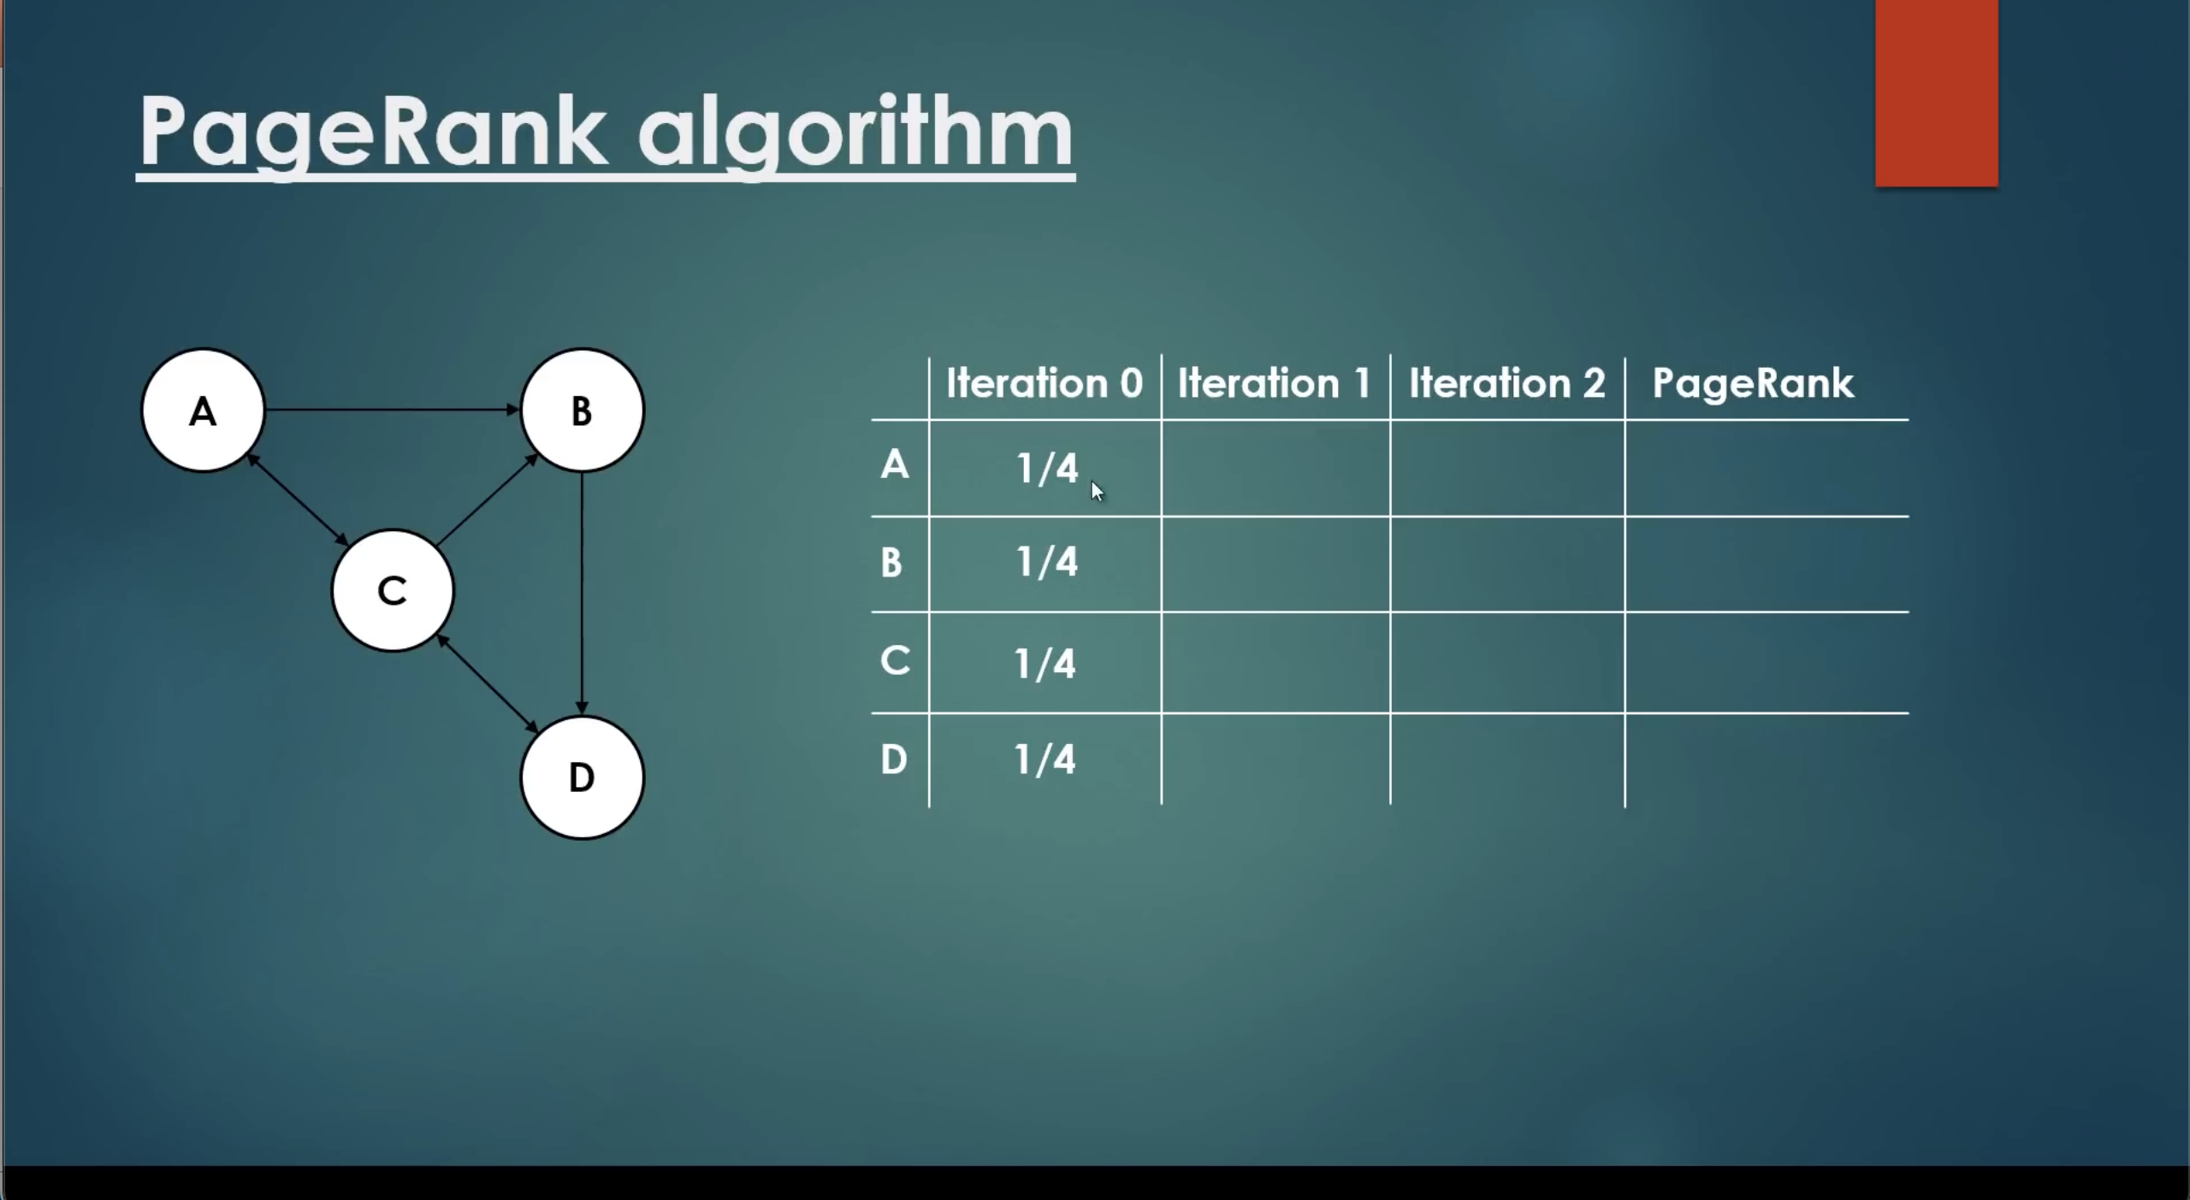
Initilize all page ranks using uniform distribution at iteration 0

Slide 11

Calculate PR(A) at iteration 1

Slide 12
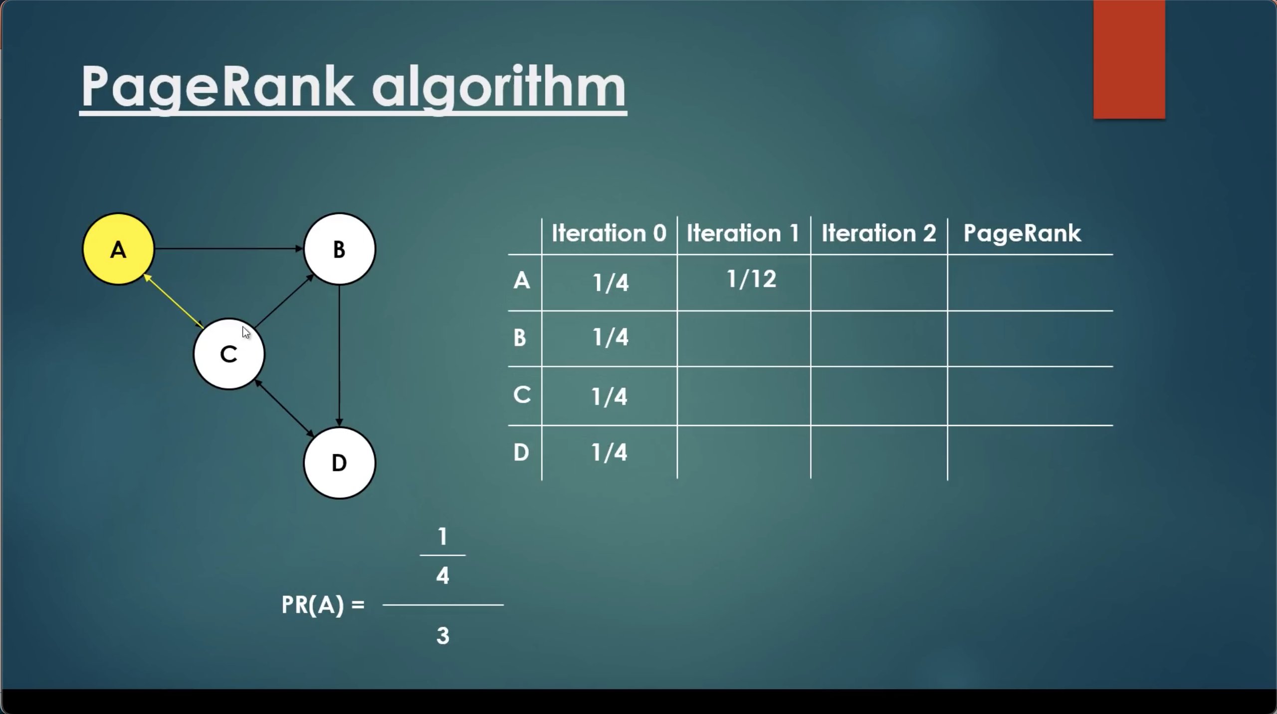
1/4 = rank of page A in previous iteration
3 = incoming/backward link of A is from C and C has 3 outgoing/forward links

Slide 13
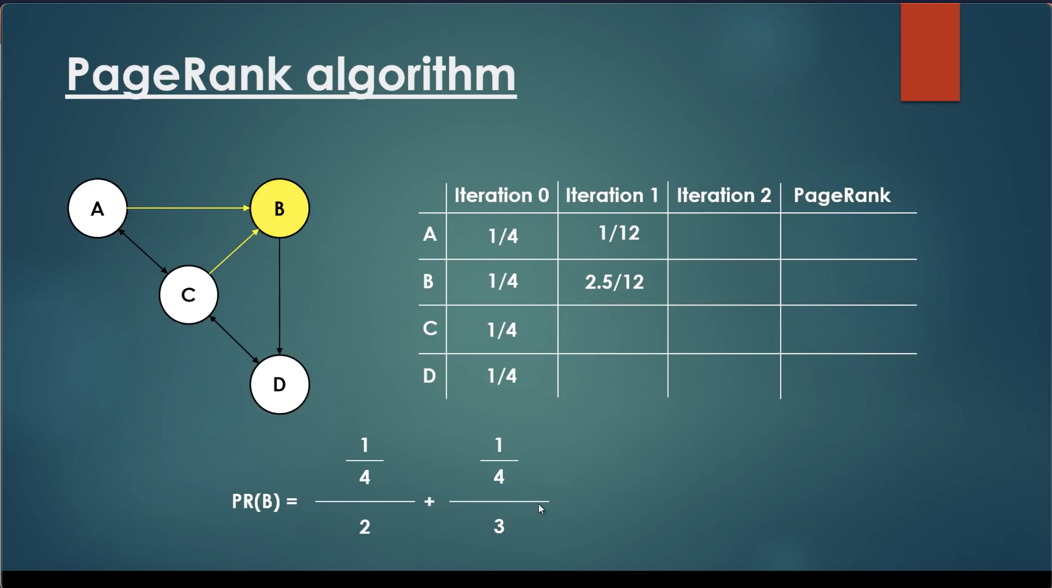
1/4 = rank of page B in previous iteration
= incoming link from A and A has 2 forward links
3 = incoming link from C and C has 3 forward links

Slide 14

1/4 = rank of page C in previous iteration
= incoming link from A and A has 2 forward links
1 = incoming link from D and D has 1 forward links

Slide 15
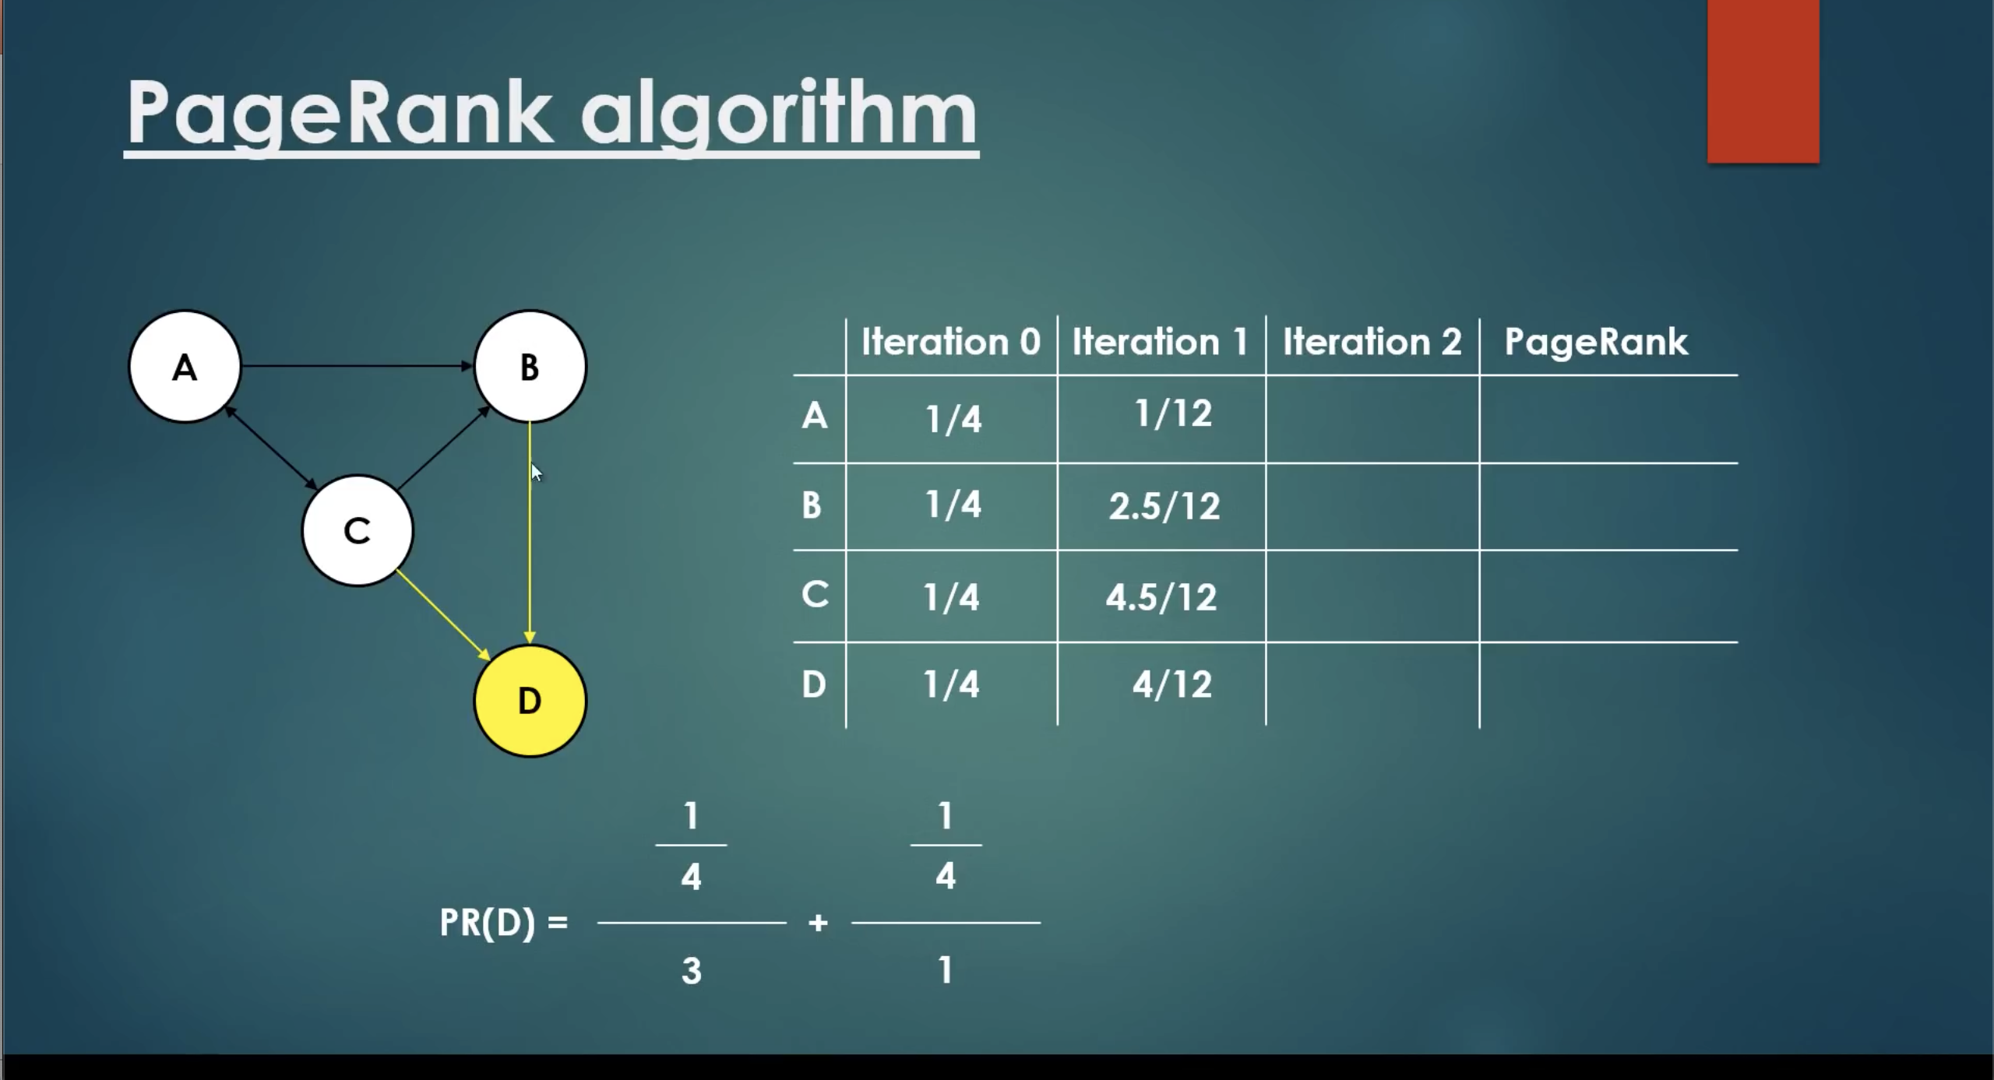

Slide 16
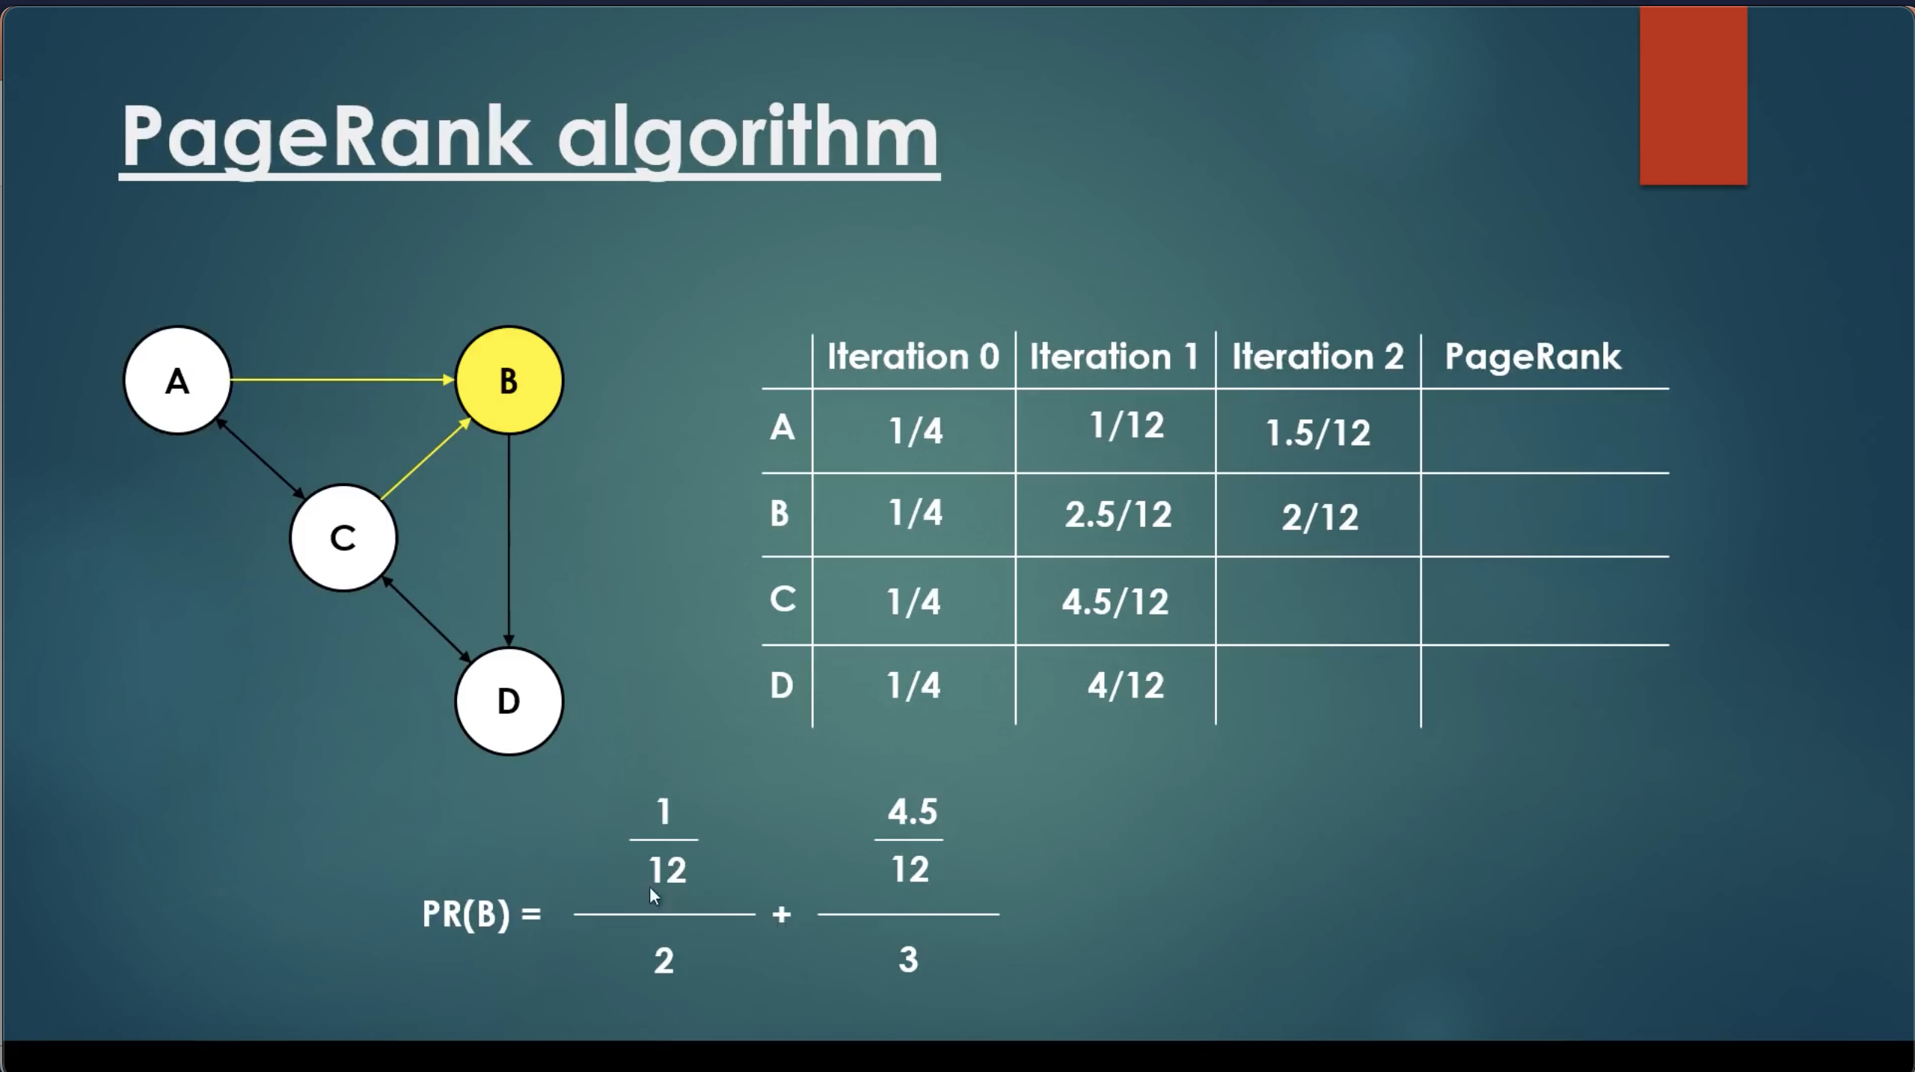

Slide 17


Slide 18


Slide 19
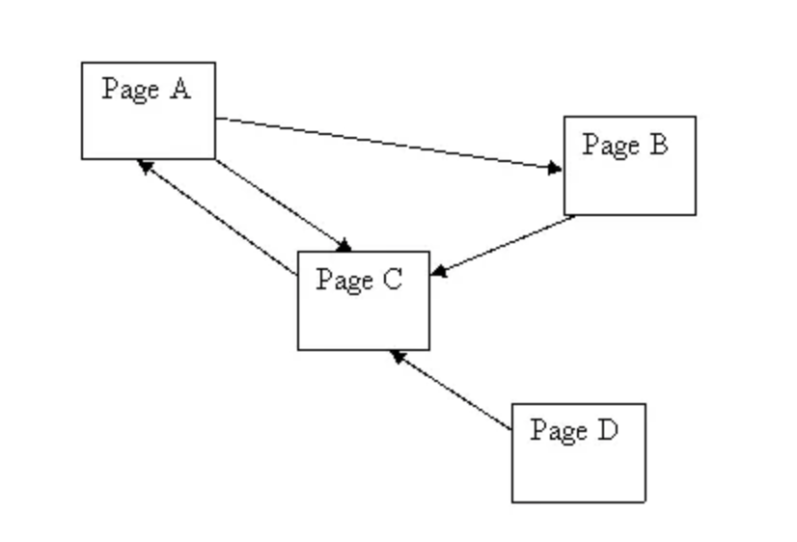
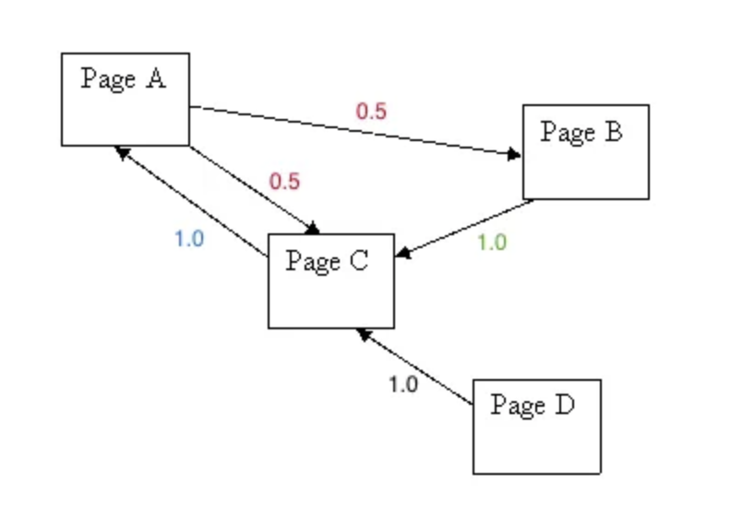
Weighted Edges

Slide 20
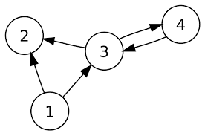
[Q. 1] Find Page rank of all these pages up till 3rd iteration damping factor d=0.8
PR(A) = (1-d) + d (PR(T1) / C(T1) + ….. + PR(Tn) / C(Tn) )
Notes:
20

Slide 21
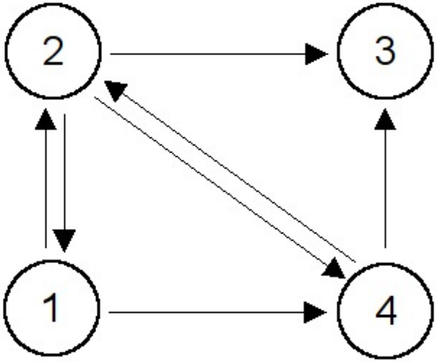
[Q. 1] Find Page rank of all these pages up till 3rd iteration damping factor d=0.8
PR(A) = (1-d) + d (PR(T1) / C(T1) + ….. + PR(Tn) / C(Tn) )
Notes:
21

